Slide 1
Pine wilt disease

Slide 2
Phytotoxin Hypothesis
Cellulase Hypothesis
Terpenoid Hypothesis
This paper reviewed the hypothesis of the pathogenic factors of the pine wilt disease. The hypothesis of phytotoxin, cellulase and ter penoid were discussed.

Slide 3
Wang et al
***START OF PAGE 3*** Wang et al. 439 Figure 1. Spin–echo T1–weighted magnetic resonance images (transverse–slice) of inoculated seedling from 1 to 25 days after inoculation. Cavitated xylem appears as dark patches. Repetition time (TR) =500 ms, echo time (TE) = 22 ms, 256 × 256 pixels. Stem diameter 9 mm. Reproduced from Utsuzawa SK 1990). By observation Kuroda (1992) found that xylem water–blockage caused by cavitation started one week after nematode inoculation. Kuroda (1989) found that parenchyma cells, which were injured by moving and feeding of nematode, syn- thesized terpenoids. Seven monoterpenes from infected pine trees: ?–pinene, ? camphene, ?–pinene, myrcene, limonene, ?–phellandrene, and p–cymene, were detec- ted. Volatile terpenoids evaporated in tracheids under negative pressure and made bubble. Refilling of cavitated tracheids with water was prevented by hydrophobic effects of terpenoids, therefore, permanent cavitation enlarged gradually. Consequently, cavitated areas reached to cambium, water translation was broke, finally pine trees died due to the water deficit. Ethylene acts as a signal transduction material to cause terpenoid produce in pine trees, experiments asso- ciated with ethylen have been done. Ethylene product was inoculated into seedlings which increased several times greater in the disease development which began a few days earlier than the water potential decrease and chlorosis in needles. Ethylene increase occurred syn- chronously with cambial death, and they were followed by water deficiency in leaves. After being injected with 0.1– 1% ethrel (2–chlorophenylphosphonic acid) solution to seedlings, embolism in tracheids widely occurred and needles turned yellow quickly. A large embolized area was produced in xylem both above and below the injection site. Some days later it developed to almost the whole transverse area of the xylem. Furthermore, denaturation of xylem and cortex parenchyma cells were produced. Ethylene produced in xylem seems to trigger the cytological changes in xylem parenchymatous cell, embolism in tracheids and chlorosis of old needles (Fukuda, 1997). Utsuzawa (2005) has observed the xylem cavitation caused by PWD by using the magnetic resonance for living trees, rather than by staining part of tree xylem which have to be sectioned. Through the nondestructive observation, he found that cavitaiton was limited to the inner xylem for about 10 days after infection, and the number of cavitated patches and the area of cavitation slowly increased. After 15 days, the cavitation area enlarged rapidly and reached the cambium, and at 21 days the relative area of cavitaion reached near 100%. Water conduction was completely dysfunction and the tree became wilting and dead (Figure 1). According to the symptoms, the development of pine wilt disease was divided into two stages: early and advanced stage (Fukuda, 1997). In the early stage, nematodes migrate through cortical and xylem resin canals in pine stems. They induce cavitation (breaking off the water column in tracheids), embolism (filling of the tracheids with gas) and occlusion of the tracheids with resin; in transverse sections of the stem, the affected tissues appear as dry patches. In the advanced stage, the nematodes multiply and destroy the cambium, which induces dysfunction of water conduction in the entire xylem and causes water potential, transpiration, and photosynthesis to rapidly decrease. Consequently, the needles wilt and the tree dies suddenly. The first stage is within 7 to 14 days and the advanced stage is during 15 to 30 days (Figure 2). PWN AND BACTERIA HYPOTHESES The bacteria carried by the PWN play an important role in pathogenicity of PWD. Oku et al. (1980) and Higgins et al. (1999) reported that bacteria were associated with ***END OF PAGE 3***

Slide 4
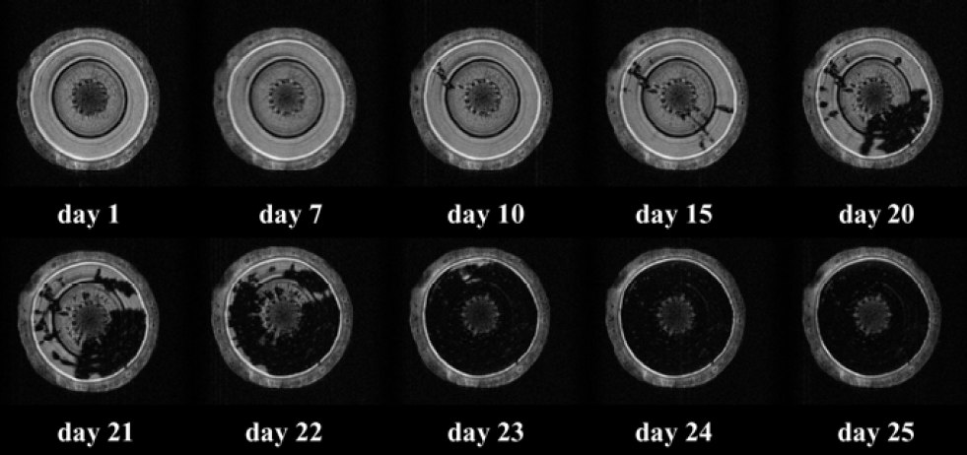

Slide 5
Phytopathogenic nematode
The present study aimed to investigate the effect of bacteria associated with pine wood nematode (PWN) on the wilting of Pinus thunbergii.

Slide 6
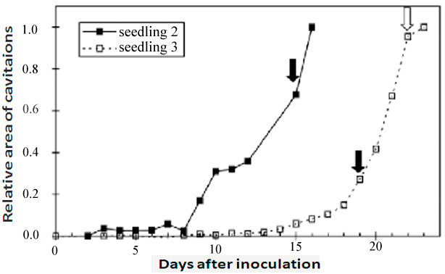

Slide 7
Pathogenicity of Pine Wilt Nematode
The pine wilt disease (PWD) is a serious disease of pine trees in Japan and Korea. The disease is caused by a pine wood nematode (PWN) Bursaphelenchus xylophilus. This article reviews the pathogenic mechanism of PWD.

Slide 8
the the the the the the the
Bursaphelenchus xylophilus, the pine wood nematode (PWN), is a devastating pathogen of many pine species. It is a vector of a pathogenic bacterium, Xylella fastidiosa, which is the cause of the disease. In this review, we describe the PWN and its associated bacteria, the symptoms of the disease and its distribution.

